Slide 1
Industry Vertical
‘Lighting up AI’ in Banks and Credit Union customers
Notes:
Slide Structure:
Slide 1: Title + Hook
Title: "Accelerating Banking Operations with AI & Automation"
Subtitle: [Prospect Bank Name] + Workato
Visual: Banking imagery (not stock handshake clichés)
Script: "Thanks for the time today. I want to share how leading banks are using automation to transform loan processing, compliance, and customer experience..."
Slide 2: The Challenge (Industry-Specific)
Headline: "Banks Are Caught Between Growth Pressure and Operational Complexity"
Content (3 visual stats):
📉 "Customer expectations: Same-day loan decisions"
⚠️ "Reality: 7-14 day processing times, 23% abandonment"
💰 "Impact: $4.2M in lost revenue annually for mid-size banks"
Visual: Icons + brief stats (not bullet points)
Script: "What we're hearing from banks like yours: customers expect instant decisions, but manual processes across Salesforce, your LOS, and core banking create bottlenecks..."
Slide 3: The Workato Approach (Solution Framework)
Headline: "Orchestrate Data, Systems & AI Across Your Banking Operations"
Content (3 capability pillars with icons):
🔗 Connect Everything: 1200+ connectors (Salesforce, nCino, Temenos, SAGE, Guidewire)
🤖 Add Intelligence: AI agents for underwriting, fraud checks, compliance
⚡ Empower Teams: Business users build workflows, not just IT
Visual: Simple architecture diagram showing systems flowing through Workato
Script: "Workato sits in the middle, orchestrating data between your CRM, loan origination, core banking, and compliance systems. Your business teams can build and modify these workflows without waiting on IT..."
Slide 4: Proof (Customer Success Snapshot)
Headline: "[Similar Bank/Credit Union] Achieved These Results in 6 Months"
Content (Before/After metrics):
Loan processing: 7 days → 4 hours ⚡
Cost per loan: $450 → $180 💰
Compliance violations: 12 → 0 ✅
FTE redeployed: 15 employees to customer service 👥
Visual: Customer logo + headshot + quote (if approved)
Quote: "Workato gave us the agility to launch new products without rip-and-replace." - VP Digital Banking
Script: "Here's a credit union similar to you in size and tech stack. They were struggling with the same loan processing bottleneck. After implementing Workato..."
Slide 5: Next Steps (Clear CTA)
Headline: "Let's Explore What's Possible for [Prospect Name]"
Content:
✓ Discovery Workshop (2 hours): Map your loan origination process
✓ Value Assessment (1 week): Quantify your automation opportunity
✓ Pilot Use Case (30 days): Prove ROI with one workflow
Visual: Simple timeline graphic
CTA: "Can we schedule a 2-hour workshop with your lending and IT teams?"
Script: "I'd love to do a deeper dive on your specific environment. We typically start with a discovery workshop where we map your current loan process, identify automation opportunities, and build a business case..."
Customization Zones for Partners/Sellers:
Slide 1: Add partner logo (if GSI co-sell)
Slide 2: Swap industry stats (use different challenge if prospect cares more about compliance than loans)
Slide 4: Change customer proof to closest match (community bank vs. regional bank vs. credit union)

Slide 2


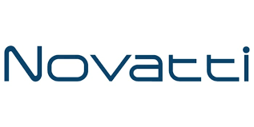

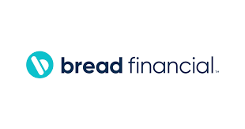

Top main penthouse message
6 logos of approved customer logo usage in subvertical
Accounts opened.
Loans approved.
Customers answered.
Getting work done!
Notes:
Top vertical segment messaging

Slide 3
Industry trend - top level statement
3-4 Value drivers, align to WSS
Big scary stat if they do nothing. Has to be substantiated
Notes:
Align with Value drivers of WSS.
—--------
Discover time - what are you needed to solve??

Slide 4
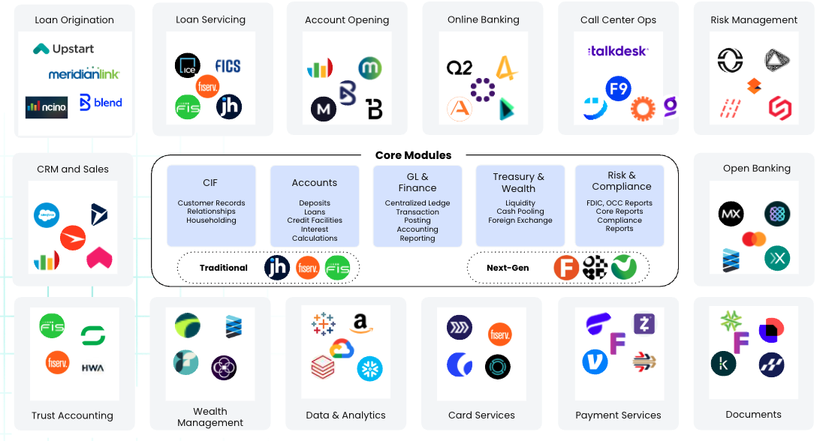
‘Industry Vertical’ Ecosystem

Slide 5
How Workato connects the ecosystem
Enterprise MCP Server Templates
Genie templates
Connectors
Workato and partners
Notes:
How do we fit into the Banking ecosystem.
Connectors - Orchestration out

Slide 6
Use cases
#1 - Title of use case
#2 - Title of use case
Summary of use case #1
Summary of use case #2
#3 - Title of use case
#4 - Title of use case
Summary of use case #3
Summary of use case #4

Slide 7
Use Case #1 - detail
Overview
Configuration / Ecosystem Integration
Current state ( WSS aligned)
Value / ROI metrics (not specific to any customers)
Desired state ( WSS aligned)

Slide 8
Use Case #2 - detail
Overview
Configuration / Ecosystem Integration
Current state ( WSS aligned)
Value / ROI metrics (not specific to any customers)
Desired state ( WSS aligned)

Slide 9
Use Case #3 - detail
Overview
Configuration / Ecosystem Integration
Current state ( WSS aligned)
Value / ROI metrics (not specific to any customers)
Desired state ( WSS aligned)

Slide 10
Use Case #4 - detail
Overview
Configuration / Ecosystem Integration
Current state ( WSS aligned)
Value / ROI metrics (not specific to any customers)
Desired state ( WSS aligned)

Slide 11
Driving value for customers
Customer one
Customer two
Customer three
Customer LOGO
Customer LOGO
Customer LOGO
Use case (s)
ROI/Value Stats
Workato products
Use case (s)
ROI/Value Stats
Workato products
Use case (s)
ROI/Value Stats
Workato products
Short quote?
Notes:
Links to each of the customer reference packages.

Slide 12









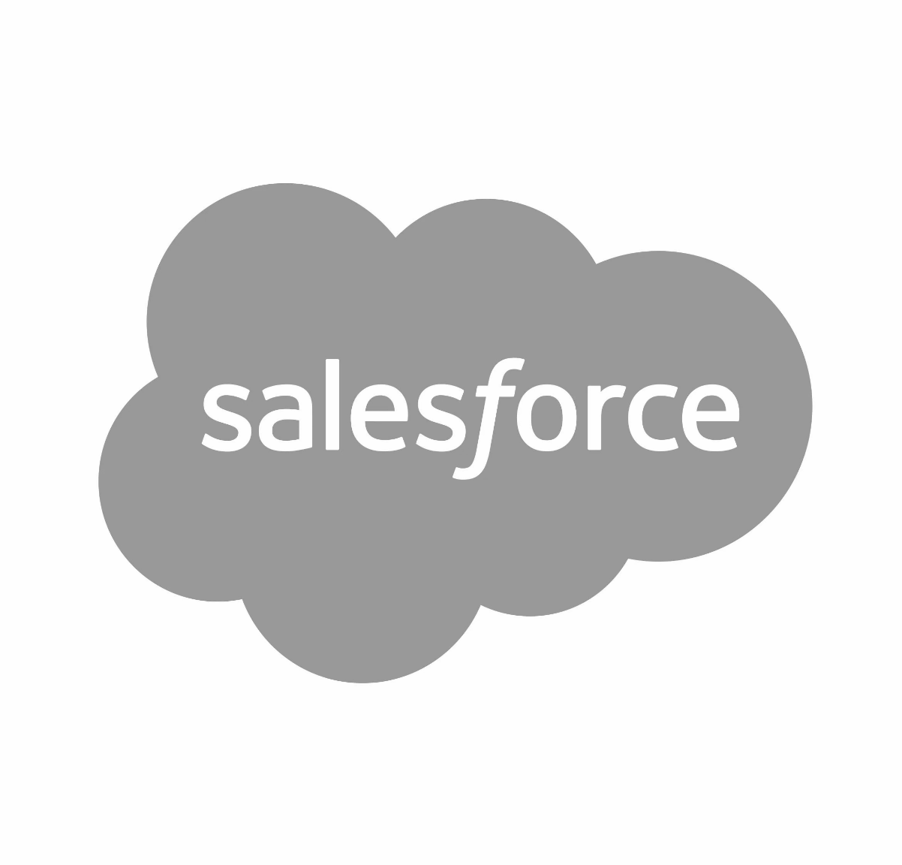



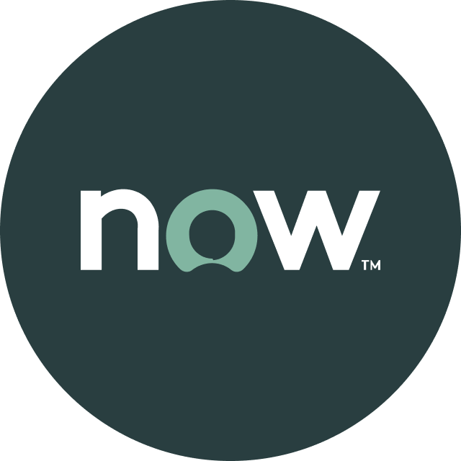


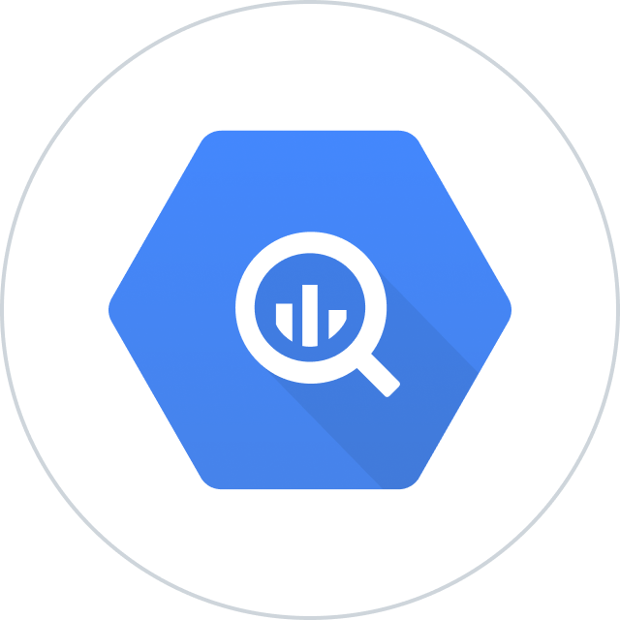


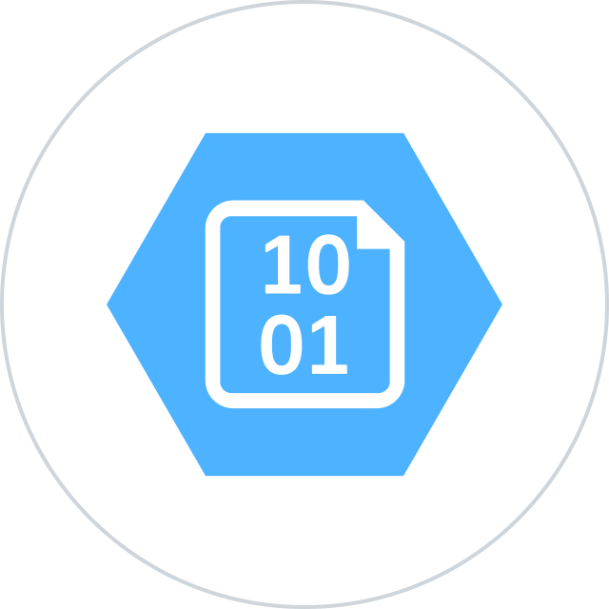


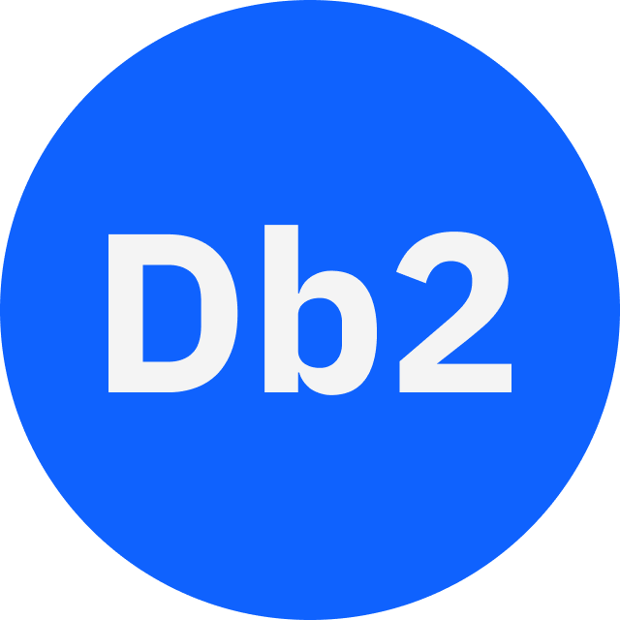



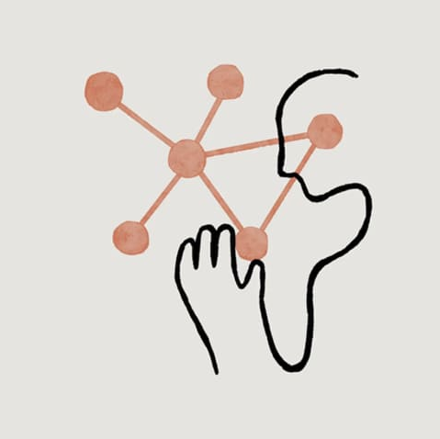
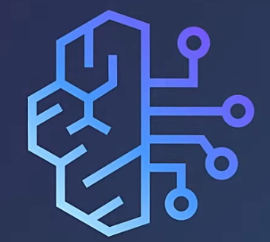
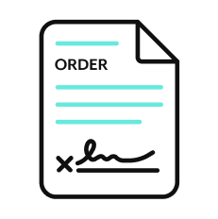

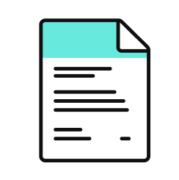
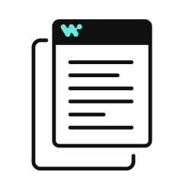




Orchestration for the Agentic Era—Powered by the #1 iPaaS.
I
Build agents with us
Go faster with Enterprise Skill packs and Workato Genies
W O R K A T O E N T E R P R I S E M C P
P L A T F O R M A G E N T S
E N T E R P R I S E S K I L L S
T R U S T
MCP Gateway
Observability
Solution Architect (AIRO™)
Skills Builder
MCP Composition
MCP Registry
MCP Proxy
Governance
O R C H E S T R A T I O N
Security
Data Scientist (Acumen)
Process Automation
Application Integration & B2B
Compliance
Data Orchestration
API Management
Explainability
Powered by iPaaS+
U N I V E R S A L C O N N E C T I V I T Y
SaaS/On-prem
Data Warehouse/ Data Lakes
Databases
LLMs
Unstructured
Traditional
Invoice
Media
Transcripts
Contracts
SFTP
Mainframe
Custom
Archives
Notes:
This is Workato ONE —Orchestration for the Agentic Era—Powered by the #1 iPaaS.
Unlike solutions that give you pieces of the puzzle, Workato ONE delivers the complete agentic enterprise:
Workato ONE One platform for data, apps, and agents
Workato GO puts enterprise search with Deep Action™ directly in every employee's hands
Workato Agentic builds and deploys production-ready agents with full enterprise context
Workato Enterprise MCP One trusted bridge for every agent to connect to applications and systems safely and securely
Workato Orchestrate powers complex workflows across teams, systems, and agents
All built on universal connectivity to 10,000+ applications and data sources
What makes this different? True Enterprise Orchestration.
Everyone talks about integration—APIs, MCP, basic workflows. But enterprise orchestration is fundamentally different. It's:
Transactionality that ensures every action completes or rolls back cleanly
In-sequence and exactly-once delivery so your financial transactions never duplicate
Runtime authentication and RBAC that enforces your security policies in real-time
PII obfuscation and data governance that maintains compliance automatically
Event-driven, batch, and real-time triggers that handle any integration pattern
Plus something no one else has: 1 million+ Enterprise Skills—pre-built, production-tested capabilities that encode your business logic, not just API calls. When an agent needs to "process a return," it doesn't just update a field—it orchestrates the entire business process across systems, with all the exception handling, approvals, and compliance checks your enterprise requires.
This unified approach enables true multi-agent orchestration. Your agents don't just connect—they inherit your enterprise's operational intelligence.

Slide 13
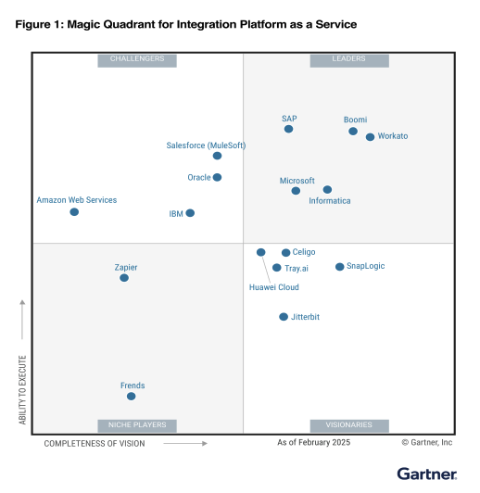
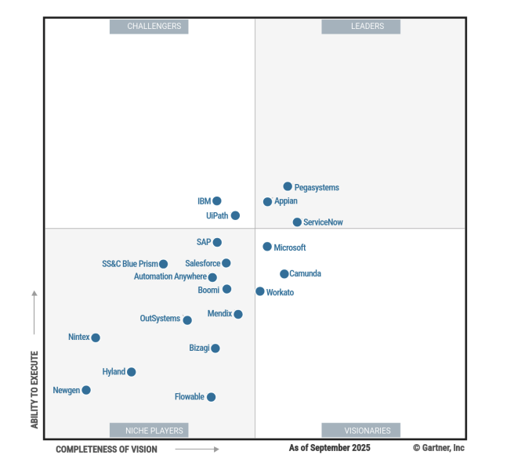
Leader in iPaas platform & orchestration
Gartner iPaas : Leader - 7x
Visionary Gartner B.O.A.T.

Slide 14

Thank you

